Slide 1
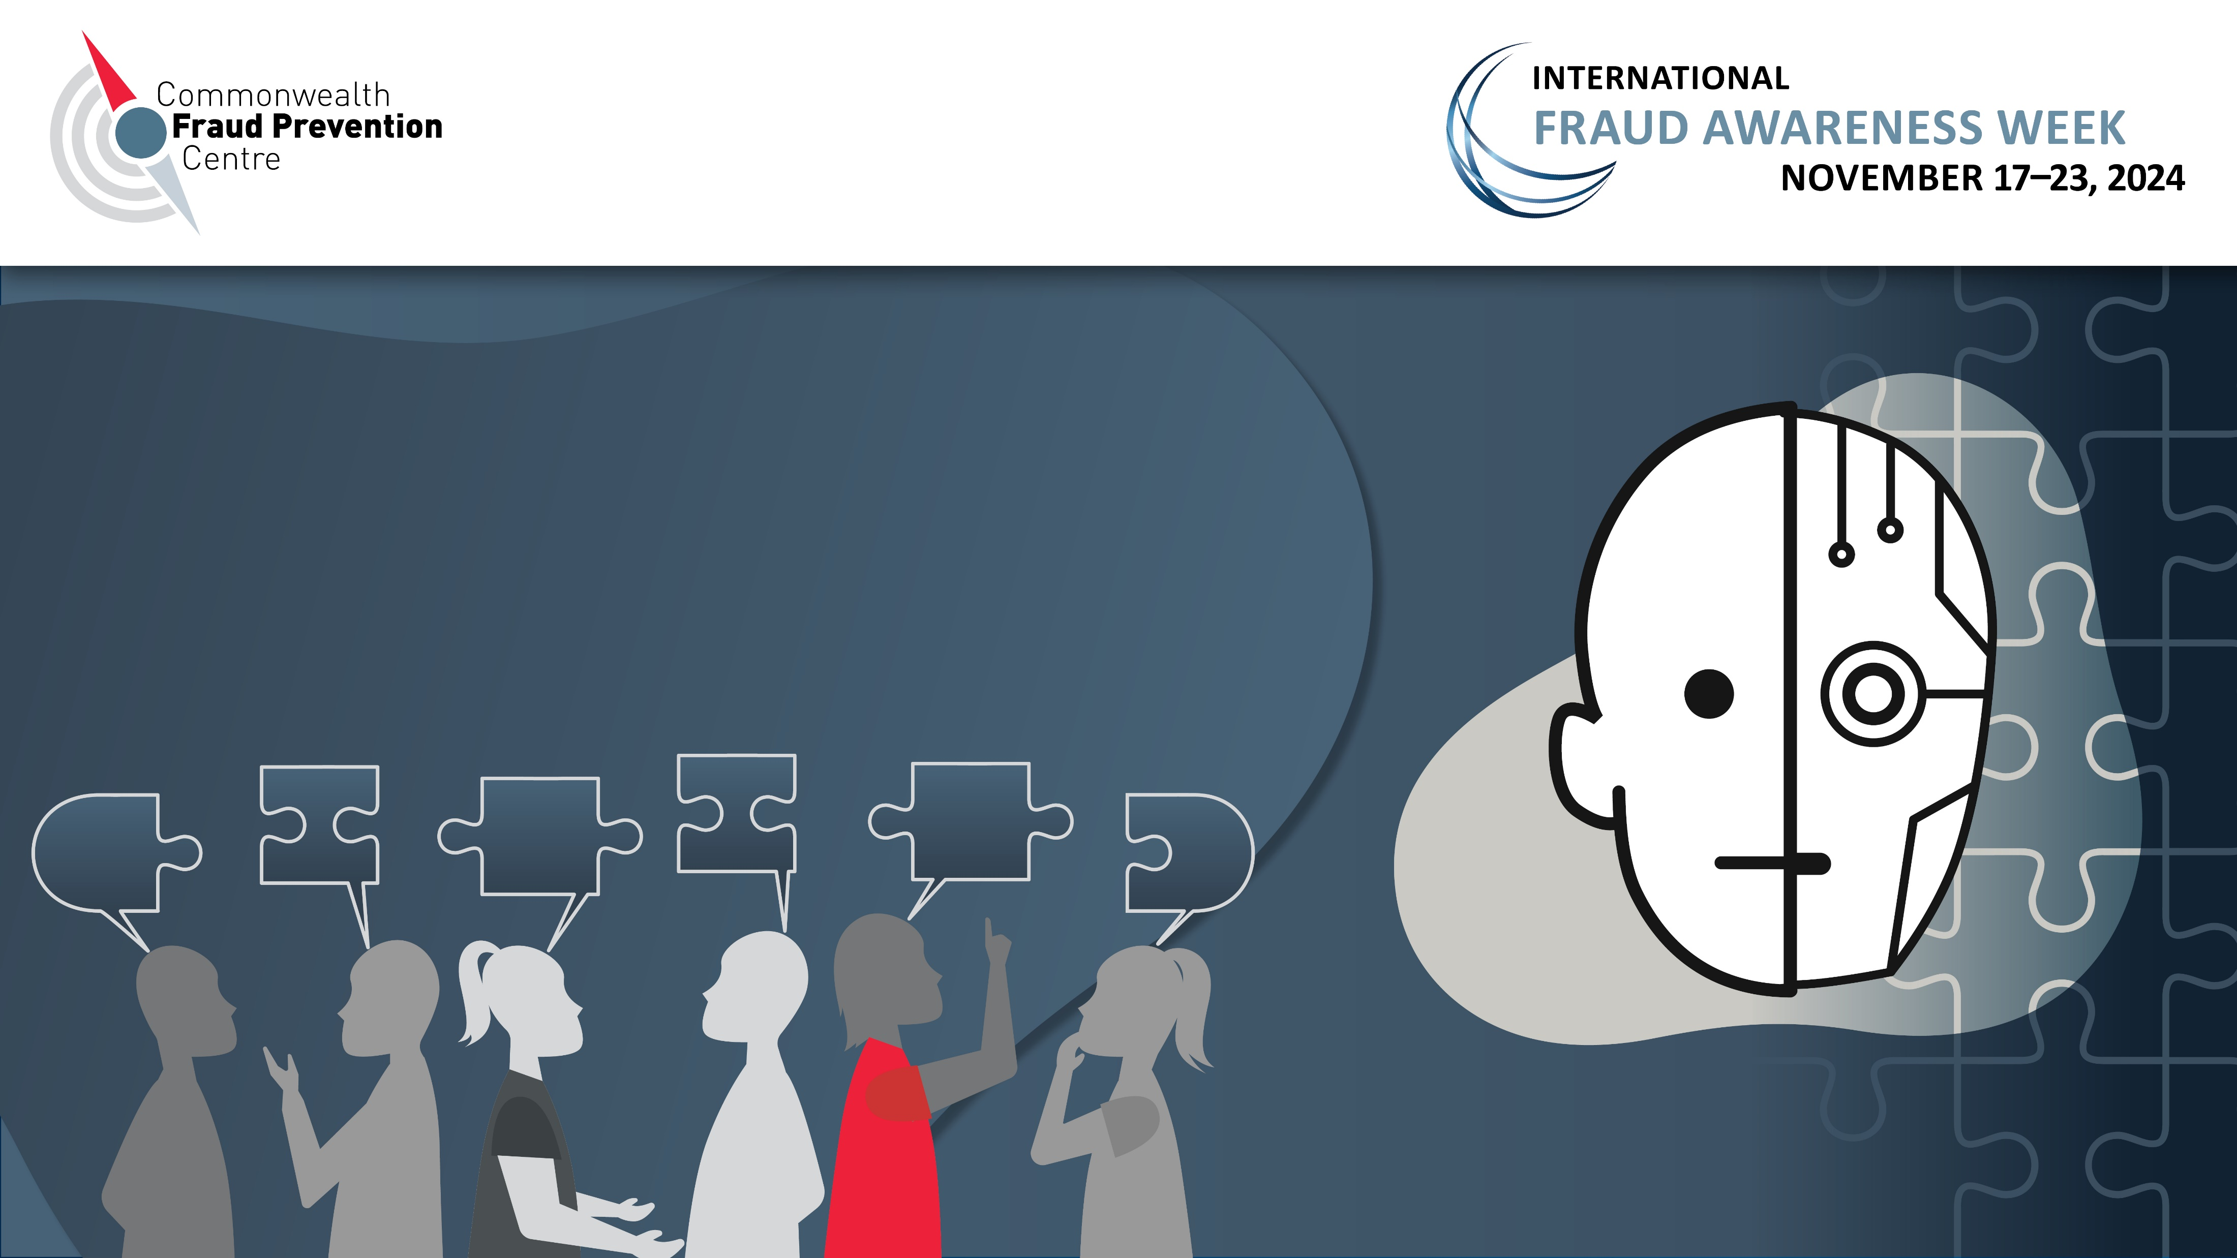
^{The face of fraud is changing}
Collaboration is more important than ever

Slide 2
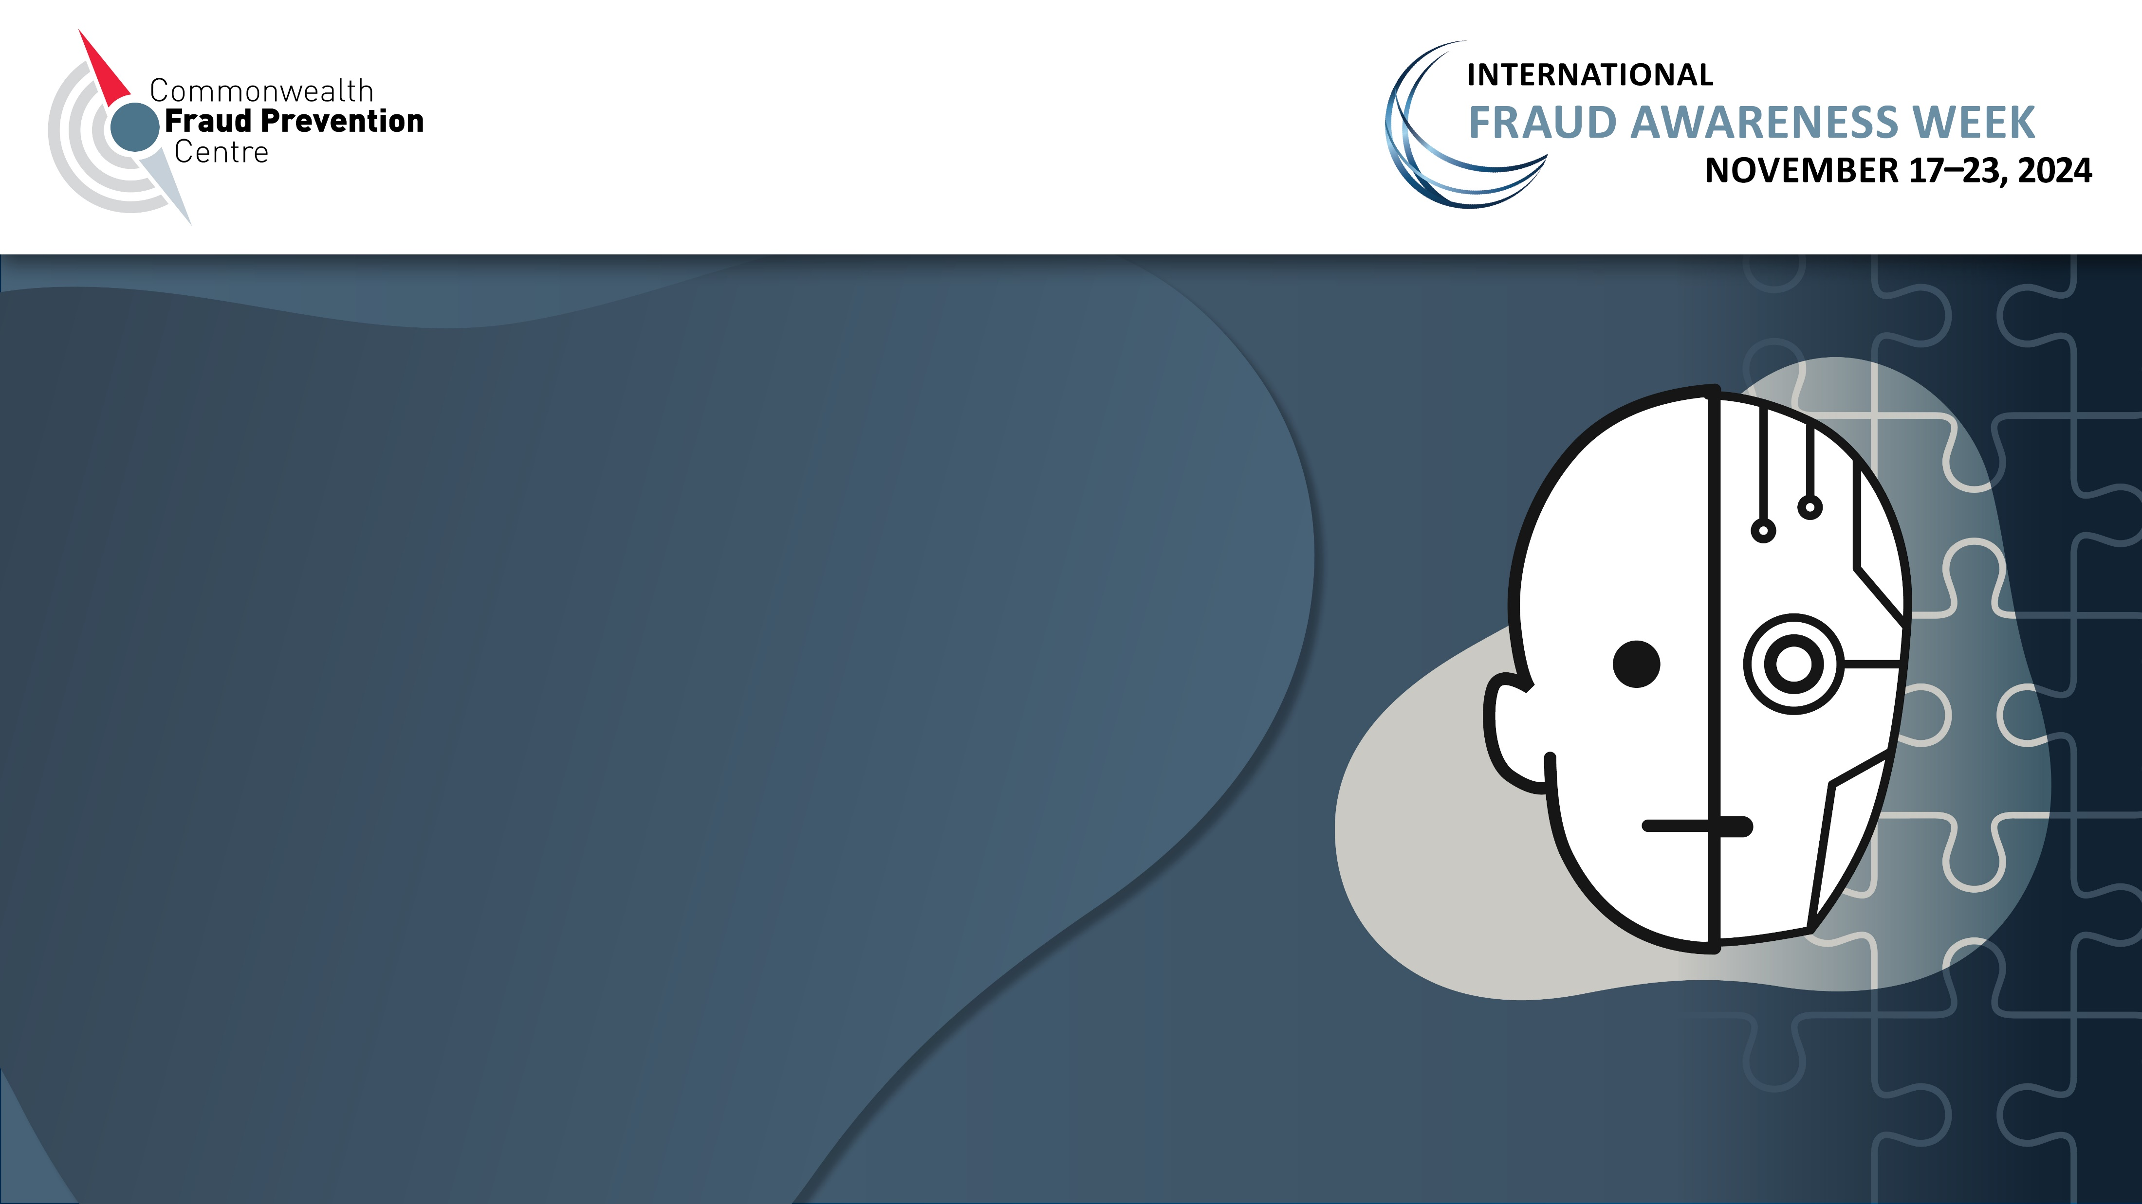
^{The face of fraud is changing}
Collaboration is more important than ever

Slide 3
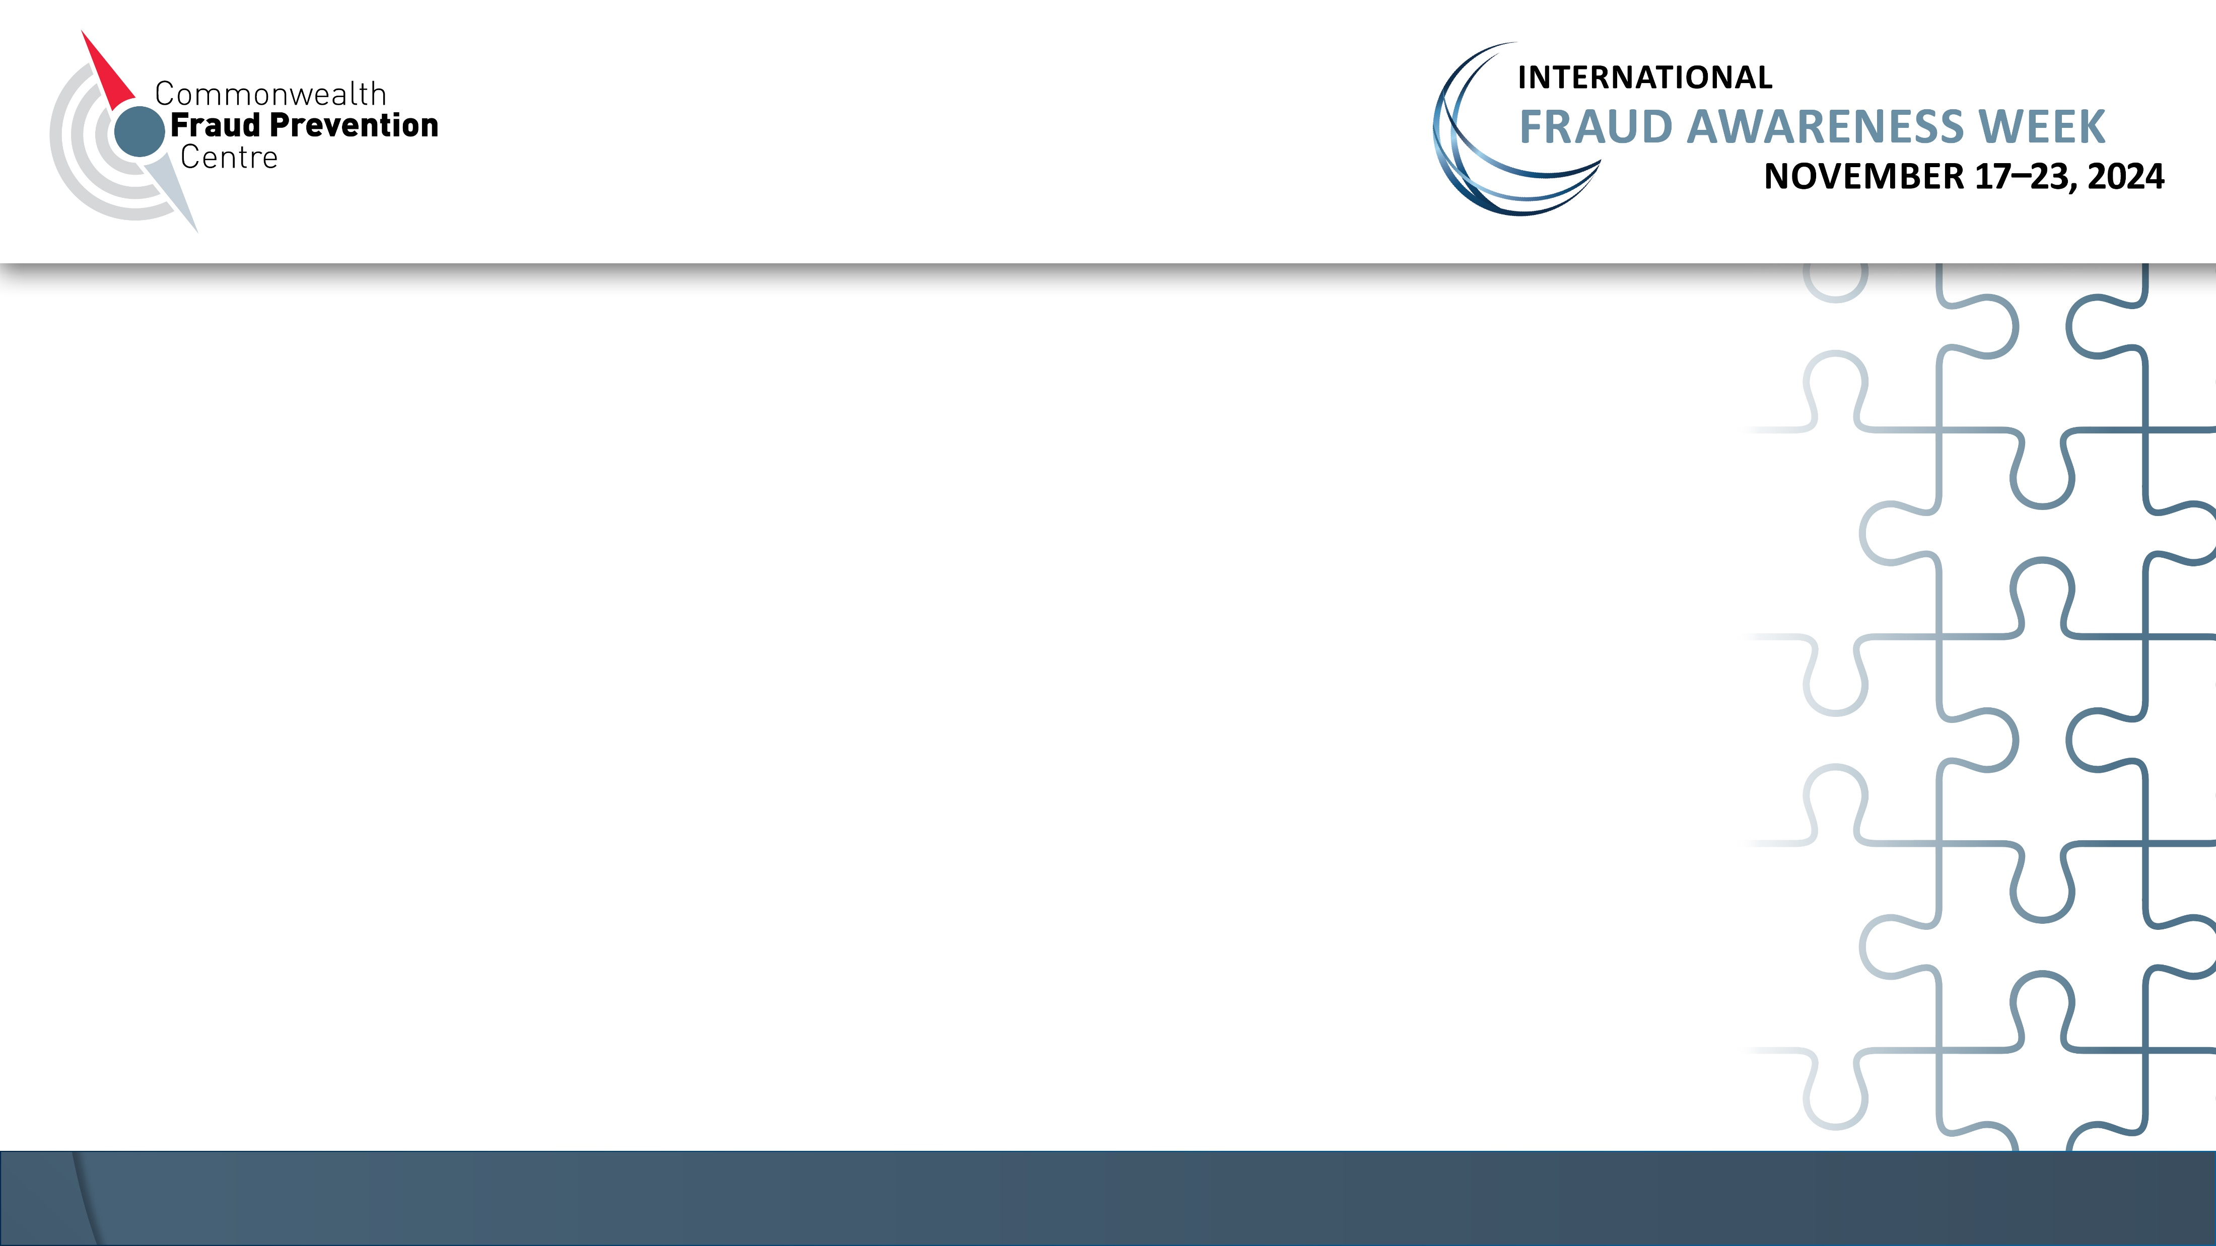
^{The face of fraud is changing}
Collaboration is more important than ever

Slide 4
