Slide 1





How to map the business process
Overview
Business process mapping is the visualisation of business processes, allowing for a more top-down view on how a business works.
A process map or flowchart describes the flow of materials and information, displays the tasks associated with a process, shows the decisions that need to be made along the chain and shows the essential relationships between the process steps.
Business process mapping uses charts, flowcharts, and symbols to address the following:
What triggers the start of a process and what are the subsequent tasks?
Why does the step/task exist? e.g. If the step is designed to stop an unintended consequence or fraud, it is a control. This question should be applied at each point of the process.
Who does each task (who are the actors in the process)?
When does each task occur?
Work collaboratively with subject matter experts to gain an informed understanding of the process you are reviewing, identify the existing controls in place and understand their design and purpose.
Benefits
The main benefit of working with stakeholders to map their business process is the introspection; it gives them a better understanding of how the business works and where is might be susceptible to fraud.
It also gives you a clear view of the different actors involved and the different activities or tasks they are responsible for.
Guide
Identify the process to be mapped and locate any existing maps that you can replicate using the process mapping template.
Invite subject matter experts to help you map out the process step by step.
Identify who are the actors in the process and create a swim lane for each actor; this includes a swim lane for systems or applications used as well.
Begin the map with the starting point of the process (the trigger). Then step through each activity or task, including what system is accessed.
Swim lane 2
Process
Input
Swim lane 3
Yes
Process
No
Output
Fraud Control Testing Framework
Business Processing Mapping Guide and Template

Slide 2
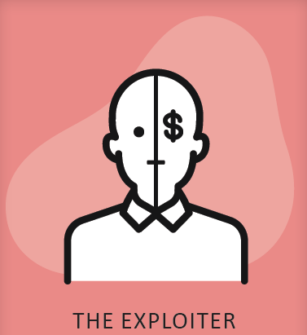
Applying a fraud lens to identify vulnerabilities in the process
Overview
Mapping the process will help you identify potential vulnerabilities in the existing controls. This must go beyond compliance checks that confirm controls are in place and processes are being followed. Fraudsters are a capable and committed adversary. Therefore, mapping processes with a fraud lens must also involve adopting a fraudster’s mindset and consider the common methods fraudsters use to find ways around controls. This helps pressure testers find vulnerabilities and challenge assumptions about how fraud is being managed within departments and public bodies.
As you step through the process, you will uncover exposure points by drilling down to the fine details of each task. To achieve this, you will need to know the touch point the controls are triggered and the purpose of each control. This technique will identify the vulnerabilities in the process.
Equipped with the fraud personas and wearing the fraudster hats will also reveal how the process can be penetrated. Completing a vulnerability assessment will help you assess the effectiveness of the controls in place.
Benefits
Using business processes mapping in this way helps you to work with stakeholders to:
Highlight how and where a fraudster could circumvent controls and exploit the process
Identify and communicate where vulnerabilities exist across the system and/or process, including those that might be enabling fraud.
Identify and measure the effectiveness of the controls in place.
Test assumptions and raise any underlying issues with stakeholders.
Guide
Once you have created the process map, walk through each task or step.
Identify different controls across the process. In the Controls Table, specifically describe the control design and purpose. Link the control on the process map to the related entry in the Controls Table with a number.
Consider the purpose for each control mechanism in place at the various touch points or activities in the process and assess the effectiveness of the control. You will then be able to identify an exposure point if the control is not assessed as fully effective. This is a vulnerability.
Using the fraudster personas, apply a fraud lens across the process by wearing the different fraudster hats, and map out how each persona could penetrate the process, taking advantage of the exposure points.
In the Vulnerabilities Table, describe the vulnerability. Link the vulnerability on the process map to the related entry in the Vulnerabilities Table with a letter.
Use this red flag to indicate a part of the process that may be enabling fraud. Label each enabler with a letter and reference in the Vulnerabilities Table.
F
Input
Use this symbol to identify controls. Number each control and reference details in the Controls Table.
4
Use fraudster personas to identify how steps may be susceptible to fraudulent actions.
Process
Fraud Control Testing Framework
Business Processing Mapping Guide and Template

Slide 3
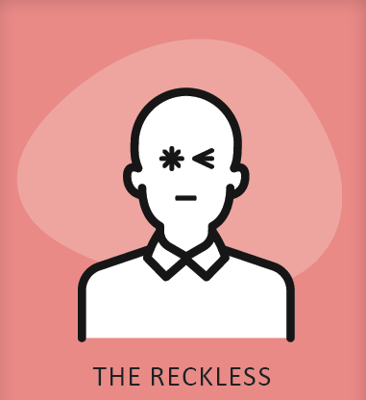

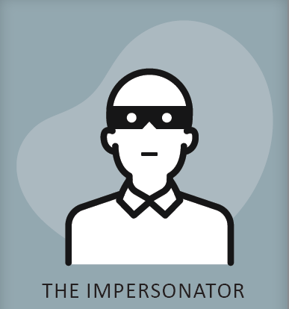



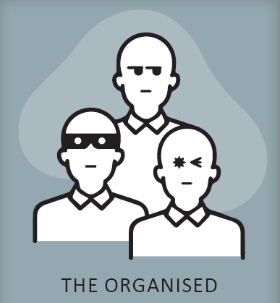
Process Mapping Symbols
Phase 1
Phase 2
Yes
Use this symbol for decision points. The symbol should correspond to a question and label the outgoing connector lines with the answer, e.g. ‘yes’ or ‘no’.
The arrows above the process represent the different phases. Label each phase. The arrows can be adjusted as needed.
No
Swim lane 2
Use swim lanes to differentiate the tasks/activities for each actor, e.g. different business units, applicants, third parties etc.
Input/
Output
Use this symbol for inputs or outputs such as data, information, report or communication.
Start/Stop
Use this symbol to indicate where the process starts. There may be multiple starts in a process. Starts and stops can be differentiated by colour.
1
Use this symbol to identify controls. Number each control and reference details in the control table.
Use connector lines to connect steps. The arrows show the path or direction of the process.
A
Use this red flag to indicate a part of the process that may be enabling fraud. Number each vulnerability and reference in the vulnerabilities table.
This might be where the process is susceptible to the actions of fraudsters (see below) or where something might contribute to fraud elsewhere in the process, e.g. insufficient data collection.
Process
Use this symbol to describe a step, process or operation. Always start the description with a verb. This should be a simple sentence that reflects what the actor will be doing.
Use fraudster personas to identify how steps may be susceptible to the common actions fraudsters use
Use Actor/Action/Outcome to describe risks
There are a range of other symbols you may wish to use depending on the level of detail you go into. You can also differentiate symbols using colours.
Information about commonly used symbols for business process mapping can be found online.
Rather than using swim lanes, which can be restrictive, you may wish to group related actions or steps using containers represented by boxes or other shapes.
Fraud Control Testing Framework
Business Processing Mapping Guide and Template

Slide 4
Example of how to use symbols
Swim lane 1
Phase 1
Phase 2
Start
Use this symbol to indicate where the process starts and stops. There may be multiple starts/stops in a process
The arrows above the process represent the different phases. Label each phase. The arrows can be adjusted as needed.
Stop
A
Use connector lines to connect steps. The arrows show the path or direction of the process
Use this red flag to indicate a part of the process that may be enabling fraud. Label each enabler with a letter and reference in the enablers table.
Output
Swim lane 2
Process
Use this symbol to describe a step, process or operation. Always start the description with a verb. This should be a simple sentence that reflects what the actor will be doing.
F
Input
B
5
H
Output
Process
Input
Use this symbol for inputs or outputs such as data, information, report or communication.
I
J
G
4
Swim lane 3
Use this symbol to identify controls. Number each control and reference details in the control table.
C
Process
1
Yes
Use fraudster personas to identify how steps may be susceptible to fraudulent actions.
Use Actor/Action/Outcome to describe risks.
E.g. A scammer (Actor) impersonates the client to deceive a processing officer into changing the bank account details (Action) to divert the payment (Outcome).
No
Use this symbol for decision points. The symbol should correspond to a question and label the outgoing connector lines with the answer, e.g. ‘yes’ or ‘no’.
3
Output
Swim lane 4
Use swim lanes to differentiate the tasks/
activities for each actor, e.g. different business units, applicants, third parties etc.
D
2
Process
Output
E
Stop
E.g. A processing officer (Actor) prevents the letter going to the client (Action) to conceal the result (Outcome).
Fraud Control Testing Framework
Business Processing Mapping Guide and Template

Slide 5
<Process Title>
<Phase 1>
Swim lane 1
Swim lane 2
Swim lane 3
Swim lane 4
Adjust phases, swim lanes or containers as required.
Note: the size of this page has been set to print on A3 format. To adjust the size and shape of this template go to the Design ribbon > Slide Size > Custom Slide Size.
Fraud Control Testing Framework
Business Processing Mapping Guide and Template

Slide 6
<Process Title>
<Phase 2>
Swim lane 1
Swim lane 2
Swim lane 3
Swim lane 4
Adjust phases, swim lanes or containers as required.
Note: the size of this page has been set to print on A3 format. To adjust the size and shape of this template go to the Design ribbon > Slide Size > Custom Slide Size.
Fraud Control Testing Framework
Business Processing Mapping Guide and Template

Slide 7
<Process Title>
<Phase 3>
Swim lane 1
Swim lane 2
Swim lane 3
Swim lane 4
Adjust phases, swim lanes or containers as required.
Note: the size of this page has been set to print on A3 format. To adjust the size and shape of this template go to the Design ribbon > Slide Size > Custom Slide Size.
Fraud Control Testing Framework
Business Processing Mapping Guide and Template

Slide 8
CONTROL Environment Assessment - Control Table
# | CONTROL | TYPE | HOW DOES THE CONTROL MITIGATE THE RISKS | CONTROL CRITICALITY | HOW THE CONTROL WAS MEASURED | EVALUATION OF CONTROL EFFECTIVENESS | RATING | RELATED VULNERABILITY
1 | Control description (Use Agent/Actor/Outcome) | Prevention Detection Response | Explain how the control is designed to mitigates fraud risk | 1-5 | Identify the method(s) used to measure control effectiveness | How was control effectiveness determined? Include evidence to support strengths or weaknesses. | Effective Partially effective Ineffective | E.g. A, C Or N/A
2 | Control description (Use Agent/Actor/Outcome) | Prevention Detection Response | Explain how the control is designed to mitigates fraud risk | 1-5 | Explain the methods used to measure control effectiveness | How was control effectiveness determined? Include evidence to support strengths or weaknesses. | Effective Partially effective Ineffective | E.g. A, C Or N/A
3 | Control description (Use Agent/Actor/Outcome) | Prevention Detection Response | Explain how the control is designed to mitigates fraud risk | 1-5 | Explain the methods used to measure control effectiveness | How was control effectiveness determined? Include evidence to support strengths or weaknesses. | Effective Partially effective Ineffective | E.g. A, C Or N/A
4 | Control description (Use Agent/Actor/Outcome) | Prevention Detection Response | Explain how the control is designed to mitigates fraud risk | 1-5 | Explain the methods used to measure control effectiveness | How was control effectiveness determined? Include evidence to support strengths or weaknesses. | Effective Partially effective Ineffective | E.g. A, C Or N/A
5 | Control description (Use Agent/Actor/Outcome) | Prevention Detection Response | Explain how the control is designed to mitigates fraud risk | 1-5 | Explain the methods used to measure control effectiveness | How was control effectiveness determined? Include evidence to support strengths or weaknesses. | Effective Partially effective Ineffective | E.g. A, C Or N/A
Insert rows to add further controls
Duplicate slide to extend table across pages
Fraud Control Testing Framework
Business Processing Mapping Guide and Template

Slide 9
CONTROL Environment Assessment - Vulnerabilities Table
# | VULNERABILITY | PERSONA (if relevant) | PROCESS PHASE/STEP | RISK OWNER | RELATED CONTROLS | RELATED VULNERABILITIES | IMPACT ASSESSMENT | RELATED TREATMENTS
A | Vulnerability description | Most relevant Fraudster Persona | What part of the process does the vulnerability apply to? | Business area and key person responsible | E.g. 1, 3, 4 | E.g. D, F | What are the direct and indirect impacts of this vulnerability? | E.g. 3, 5
B | Vulnerability description | Most relevant Fraudster Persona | What part of the process does the vulnerability apply to? | Business area and key person responsible | E.g. 1, 3, 4 | E.g. D, F | What are the direct and indirect impacts of this vulnerability? | E.g. 3, 5
C | Vulnerability description | Most relevant Fraudster Persona | What part of the process does the vulnerability apply to? | Business area and key person responsible | E.g. 1, 3, 4 | E.g. D, F | What are the direct and indirect impacts of this vulnerability? | E.g. 3, 5
D | Vulnerability description | Most relevant Fraudster Persona | What part of the process does the vulnerability apply to? | Business area and key person responsible | E.g. 1, 3, 4 | E.g. D, F | What are the direct and indirect impacts of this vulnerability? | E.g. 3, 5
E | Vulnerability description | Most relevant Fraudster Persona | What part of the process does the vulnerability apply to? | Business area and key person responsible | E.g. 1, 3, 4 | E.g. D, F | What are the direct and indirect impacts of this vulnerability? | E.g. 3, 5
Insert rows to add further vulnerabilities
Duplicate slide to extend table across pages
Fraud Control Testing Framework
Business Processing Mapping Guide and Template

Slide 10
CONTROL Environment Assessment - Treatment Summary Table
# | TREATMENT OPTIONS | PROBLEMS TO SOLVE (RELATED VULNERABILITIES) | CONSULTATION | TREATMENT OWNER | IMPLEMENTATION PROCESS | ESTIMATED COST | EXPECTED BENEFITS | EXPECTED TIMEFRAME | DECISION
1 | Describe the treatment option | Summarise the purpose of the treatment. What vulnerabilities will it address, and what will it do? | Summarise how and with whom the treatment was developed. | Business area and key person responsible | What steps will be involved? | Estimated Capital and Staffing Costs | Estimated financial and non-financial benefits | Target Date | Supported Further work req. Not supported
2 | Describe the treatment option | Summarise the purpose of the treatment. What vulnerabilities will it address, and what will it do? | Summarise how and with whom the treatment was developed. | Business area and key person responsible | What steps will be involved? | Estimated Capital and Staffing Costs | Estimated financial and non-financial benefits | Target Date | Supported Further work req. Not supported
3 | Describe the treatment option | Summarise the purpose of the treatment. What vulnerabilities will it address, and what will it do? | Summarise how and with whom the treatment was developed. | Business area and key person responsible | What steps will be involved? | Estimated Capital and Staffing Costs | Estimated financial and non-financial benefits | Target Date | Supported Further work req. Not supported
4 | Describe the treatment option | Summarise the purpose of the treatment. What vulnerabilities will it address, and what will it do? | Summarise how and with whom the treatment was developed. | Business area and key person responsible | What steps will be involved? | Estimated Capital and Staffing Costs | Estimated financial and non-financial benefits | Target Date | Supported Further work req. Not supported
5 | Describe the treatment option | Summarise the purpose of the treatment. What vulnerabilities will it address, and what will it do? | Summarise how and with whom the treatment was developed. | Business area and key person responsible | What steps will be involved? | Estimated Capital and Staffing Costs | Estimated financial and non-financial benefits | Target Date | Supported Further work req. Not supported
Insert rows to add further treatment options
Duplicate slide to extend table across pages
Fraud Control Testing Framework
Business Processing Mapping Guide and Template

